Slide 1
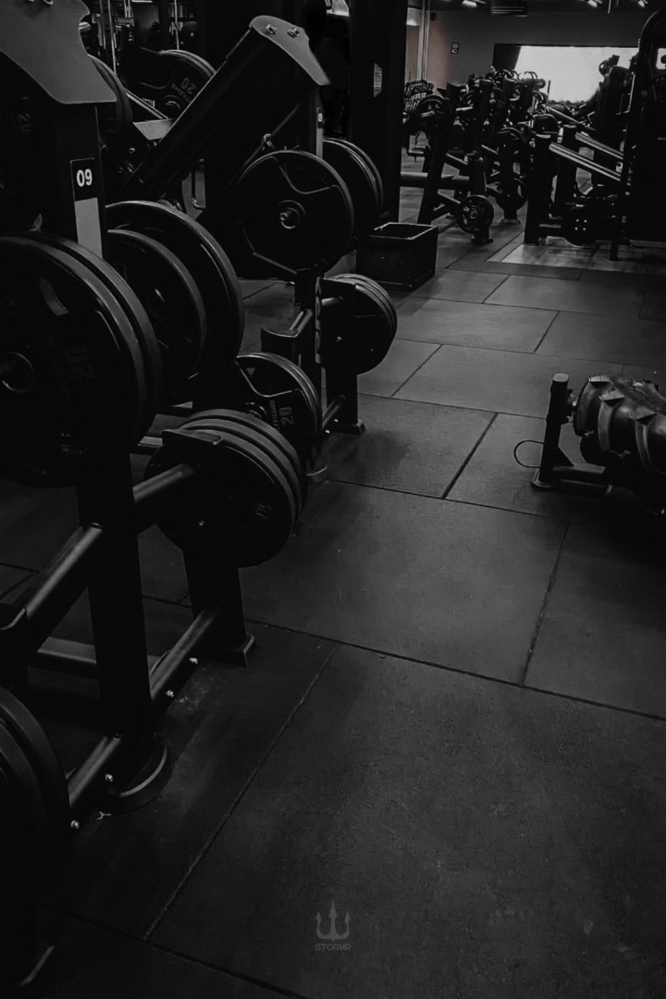
FitRealm: Your Fitness Journey Starts Here
FitRealm is a comprehensive web platform that connects fitness trainers with trainees, providing personalized guidance, expert insights, and essential fitness products to help you achieve your goals.

Slide 2
Connecting Trainers and Trainees
Trainer Profiles
Personalized Plans
Seamless Connection
Browse through a diverse selection of certified trainers, each with their own specialties and expertise.
Choose from tiered subscription plans to find the perfect fit for your fitness level and needs.
Easily connect with your chosen trainer and start your fitness journey together.

Slide 3

Fitness Resources at Your Fingertips
1
Expert Blog
Trainers share their knowledge, tips, and personal experiences to motivate and educate trainees.
2
Reviews
Trainees can provide feedback on their experiences with trainers and products.
3
Fitness Community
Connect with like-minded individuals, share progress, and support each other's fitness journeys.

Slide 4
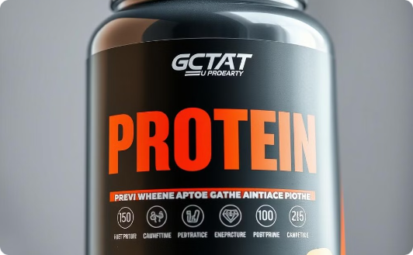

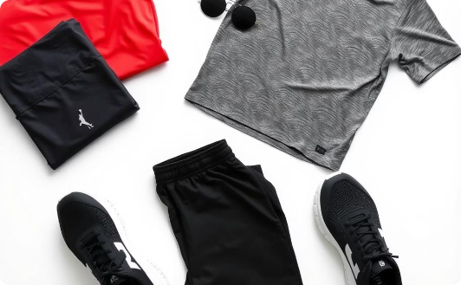
Fitness Products Made Easy
Supplements
Gym Equipment
Apparel
Explore a curated selection of high-quality supplements to support your fitness goals.
Find the essential gear and accessories to enhance your workouts and fitness routines.
Browse a selection of stylish and functional fitness apparel to keep you motivated.

Slide 5

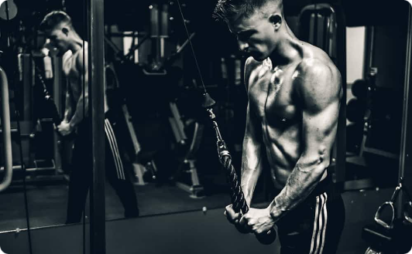
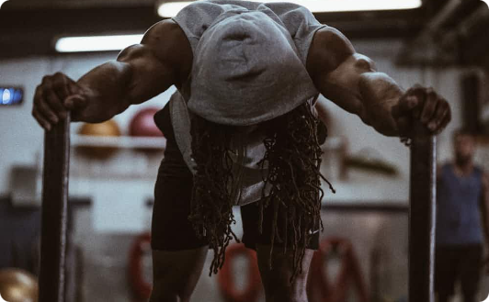
Tailored Fitness Plans
Basic
Advanced
Premium
Designed for those new to fitness, providing a solid foundation and gradual progression.
Challenges those with some experience, focusing on building strength and endurance.
Caters to fitness enthusiasts seeking a more intense and specialized training program.

Slide 6
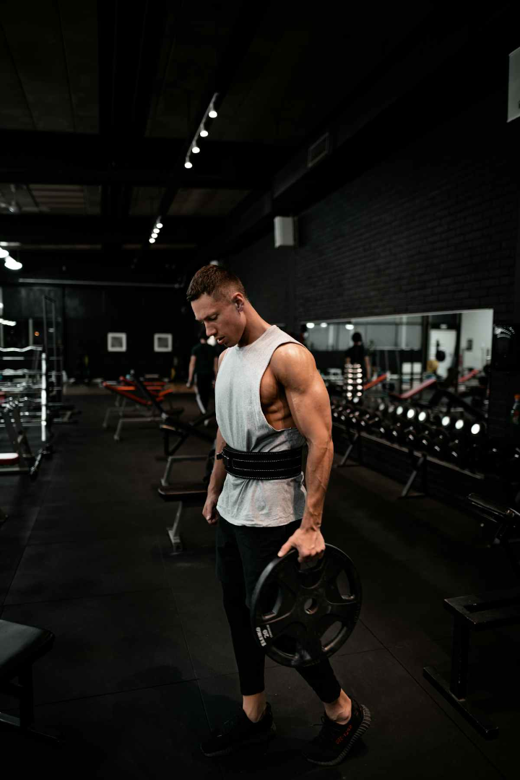




Trainer Expertise
Strength Training
Develop muscle, power, and overall body strength.
Cardio Fitness
Improve cardiovascular health and endurance.
Flexibility
Enhance mobility, balance, and mindfulness.
Nutrition Guidance
Receive personalized dietary recommendations.

Slide 7
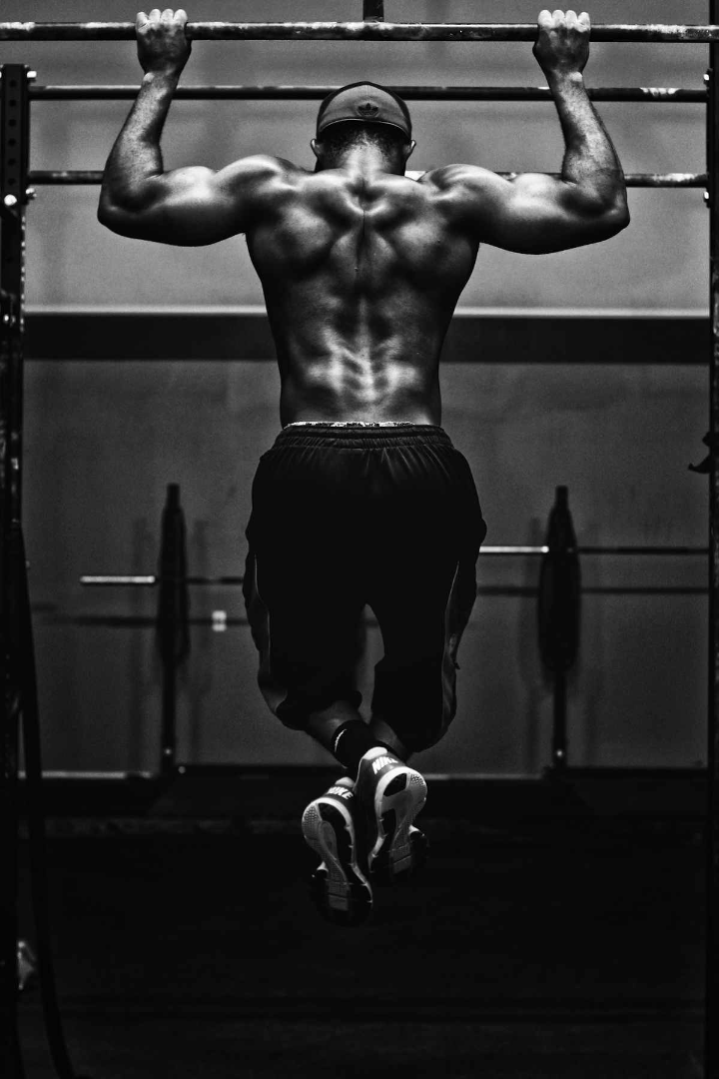
Testimonials
1
Satisfied Trainee
"FitRealm has been a game-changer for me. The personalized training plan and expert guidance have helped me achieve my fitness goals in a way I never thought possible."
2
Experienced Trainer
"As a trainer, FitRealm has provided me with a platform to share my knowledge and connect with motivated individuals who are eager to improve their health and wellness."
3
Loyal Customer
"The convenience of having access to high-quality fitness products and supplements right on the FitRealm website has been a game-changer for my fitness routine."

Slide 8
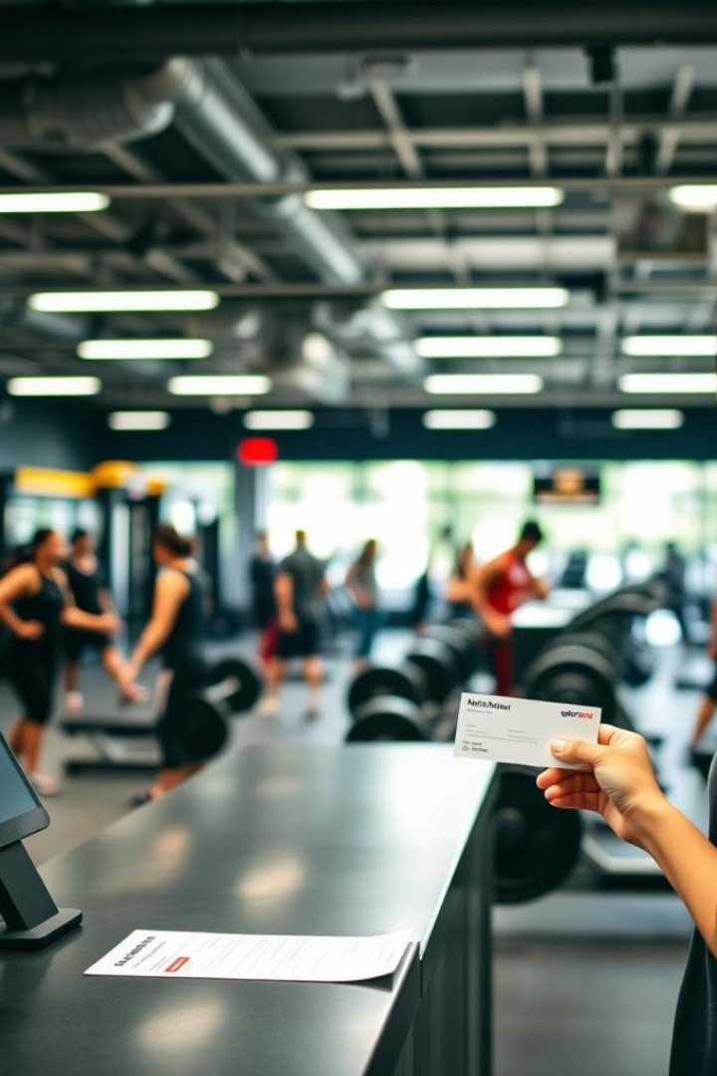



Join the FitRealm Community
Sign Up
Create your FitRealm account and choose your role as a Trainer or Trainee.
Explore
Browse through the available fitness plans, trainers, blog content, and products.
Start Your Journey
Connect with your chosen trainer, access resources, and begin your fitness transformation.

Slide 9

Our FitRealm Blogs
Discover a wealth of fitness wisdom shared by our expert trainers. Explore articles covering workouts, nutrition, wellness trends, and more to elevate your health journey.

Slide 10
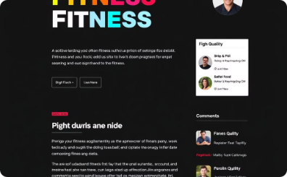


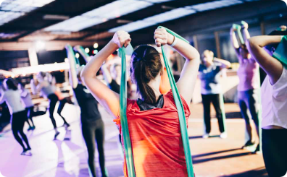
OUR BLOGS-2
Purpose:
Trainer Content:
User Interaction:
Community Building:
Share knowledge, tips, and advice on fitness, nutrition, and overall well-being. Engage users with valuable articles from expert trainers.
Trainers can add articles directly to the blog section. Articles cover various fitness topics, workouts, diet plans, and wellness trends. Articles include images and videos for better readability and engagement.
Users can interact with blog posts by leaving comments. Users can ask questions, provide feedback, and discuss ideas. Comments and feedback are displayed instantly, allowing dynamic interaction.
The comment feature encourages an interactive fitness community. Users and trainers can engage in meaningful discussions, fostering deeper connections.

Slide 11
Thank You, ITI Family!
To our Mentors
To our Peers
Your have made a huge difference in our journey. You've challenged us to improve and helped us grow with confidence on our own!
We couldn’t have asked for better teammates and friends. The laughs, late-night projects, and teamwork made it all worthwhile!
Thank you for believing in us and being there every step of the way. You're truly the best!

Slide 12
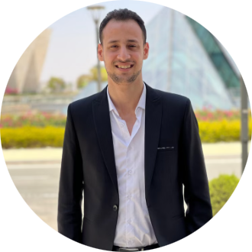
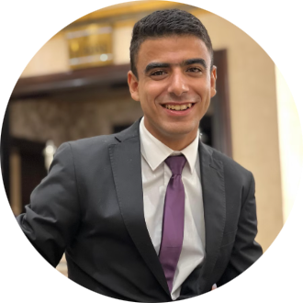
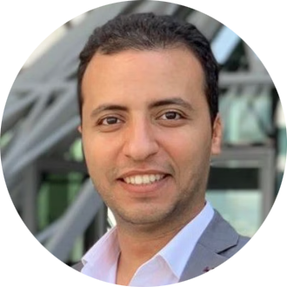
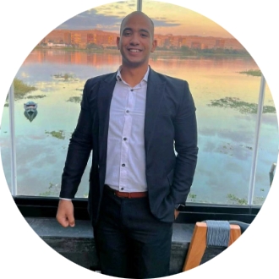
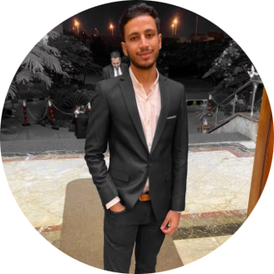
The GOATS
Ahmad Abdulmuniem
Mahmoud Elsayed
Fady Mohsen
Omar Yahia
Mahmoud Ismail

Slide 13
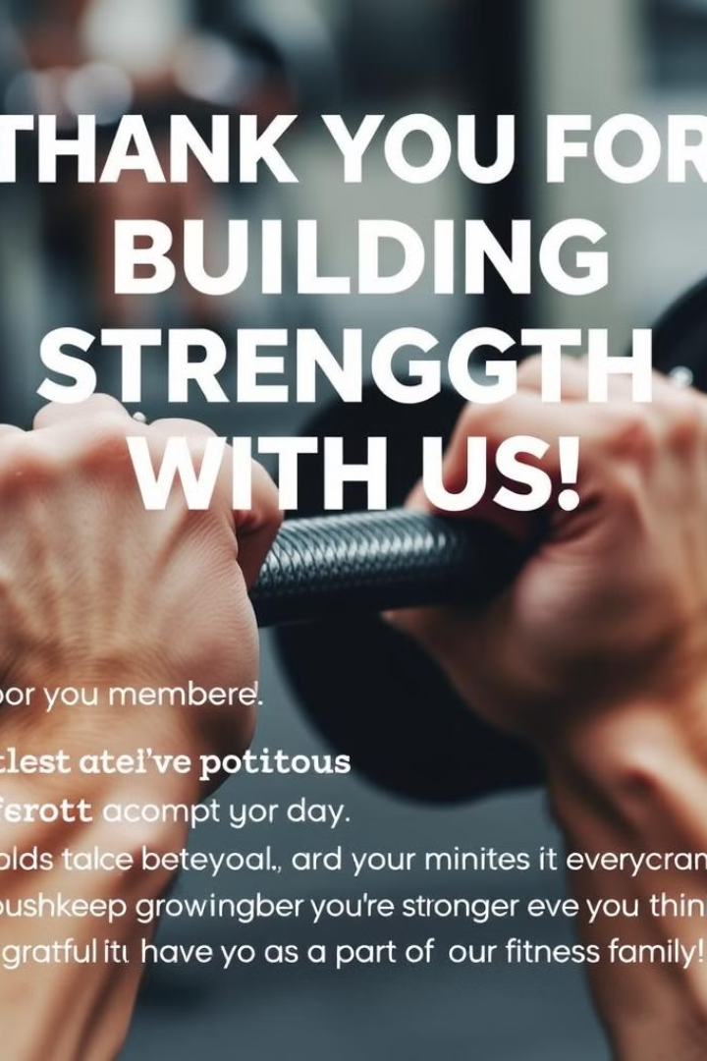
Thank You
We are deeply grateful for your support and trust throughout our journey. Your belief in us has been a constant source of inspiration and motivation.

